Slide 1
Temple of the Lost
Team: Golden Ducks
Axure Prototype Presentation
Due: Wednesday, Nov 20, 2019
Group Members:
Hussy Hussein, Jordan Odu, Frankie Reitzel, Jordan Odu

Slide 2
Introduction
Not seeing what is to come
Setting is in the dark
Learning to use what you have wisely
Limited amount of light
Everything is not as it seems
Cupcakes are bad, ducks are good
All phenomenons have to do with exploring the unexpected

Slide 3
Playthrough

Slide 4

Mechanics
Rules of the game
Players must make a choice on which door
Ducks give light
Cupcakes take it away
You can run out of light and this will cause you to lose
Duck and light replenish
Every duck gives you more light
There are limited ducks
Even with ducks you must watch how much light you use
Dark panels
Allow for the feeling of unknown
Do not follow a pattern adding a challenge

Slide 5
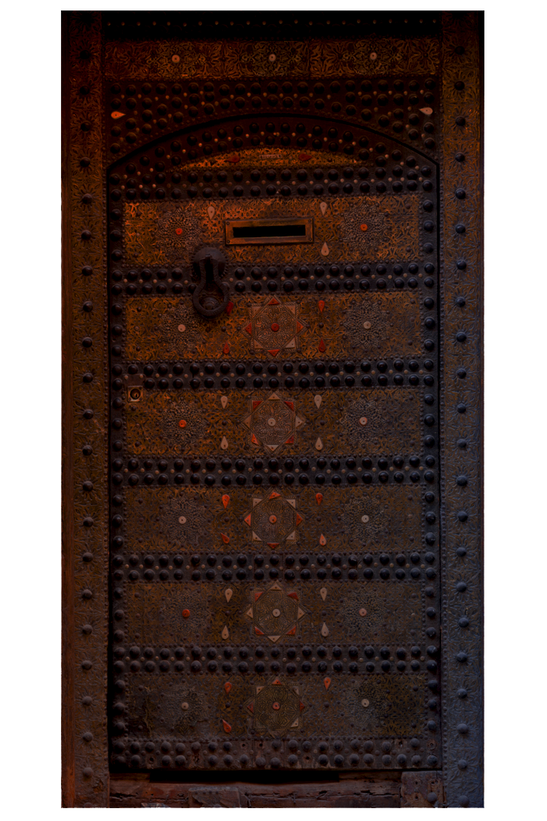
Dynamics
Skills learned throughout the game
Conserving light
Strategically picking areas
Good looking objects aren’t always good
One wrong move can end the game
What the player walks away from the game with
Using resources wisely
Becoming more aware of surroundings

Slide 6

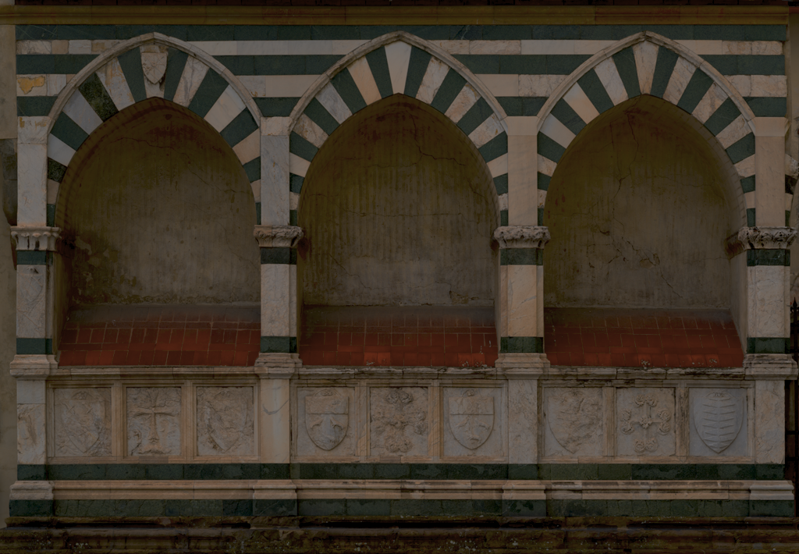
Aesthetics
Evokes a sense of perseverance
The narrative allows for a reason to continue
The reward of finding a duck
Confusion
The panels are random
The items are meant to trick the player
Responsability
Watching the resources
Keeping in mind the reason for the mission

Slide 7
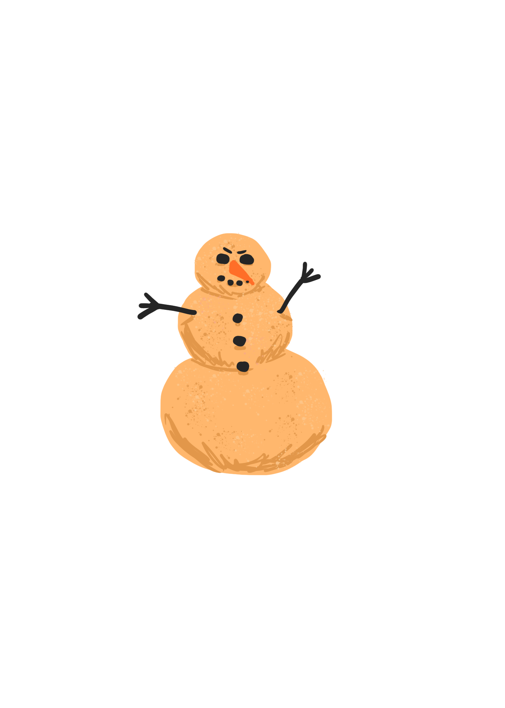
Narratives
Embedded Narrative
The player is an archeologist looking for a discovery that will make their career
To win the game, the player must find their way through the dark temple and beat the evil spirit Dwune
Emergent Narrative
Depending on how wisely and carefully the player play’s the game and the items the player chooses or does not choose, effects how far they will get in the game
How fast the player goes through a room may be their undoing
Interpretive Narrative
How closely a player pays attention to the story before the game depends on how scary they perceive the game as they play
The music can let the player know how well their progress is going
DWUNE

Slide 8
Data Model

Slide 9
Task Flow
Good Route
The good route is the longest route (four temple rooms plus the boss fight)
It was designed this way to give players a nice feel for the game, as well as to leave room for a trap in the middle that will lead to the bad route
Bad Route
The bad route is the second longest route (three temple rooms)
It was designed this way because we found that anymore routes would be too many. Three rooms would be enough for the player to loose all their light and receive a game over
Loop Route
The loop route is only one room
It is more for humor than anything else
An extra room to confuse the players and get a laugh

Slide 10
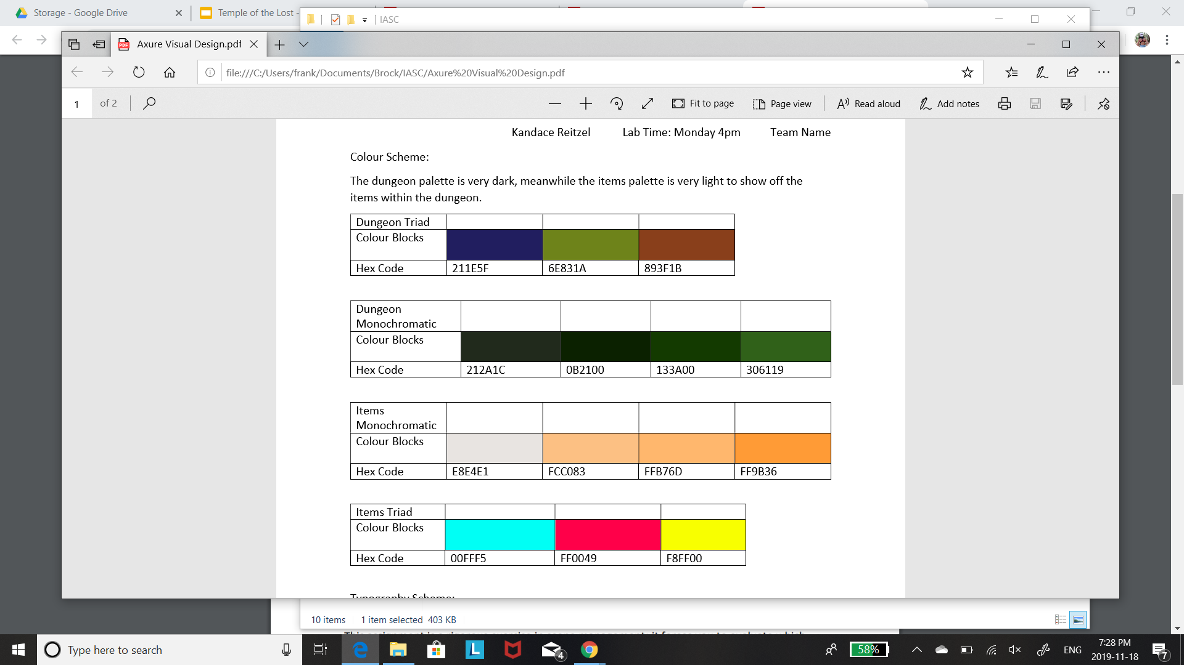
Style Guides
Light
Light was used for items
Made to contrast the dark background
Monochromatic allowed for more shade choices
Dark
Meant to give an eerie temple feeling
Much darker to contrast items
Gives the illusion of being in a dark room

Slide 11
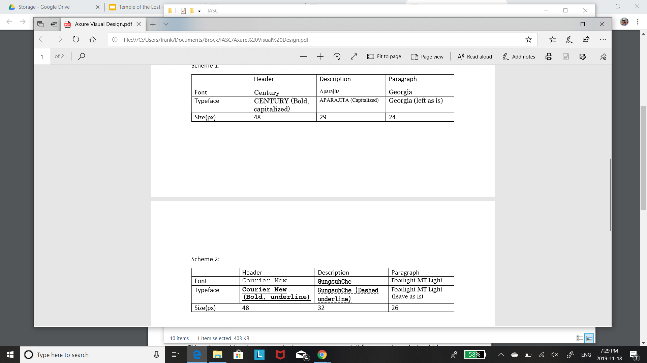
Style Guide
Fonts
Chosen to depict and old environment
Give an ancient feel to much of the game
Readable but still old looking
Some fonts were not available

Slide 12
Failures/Challenges
1.
2.

Slide 13
Improvements
More self-made graphics
Randomization
3D effects
More interaction options

